Slide 1


Differentiable simulators: a bridge between machine learning and scientific computing
Dr Aidan Crilly
Eric and Wendy Schmidt AI in Science postdoctoral fellow
Centre for Inertial Fusion Studies

Slide 2
Outline
Context
Differential equations
Adjoint state problem
Automatic differentiation
Differentiable programming
Neural differential equations
Example in my research

Slide 3
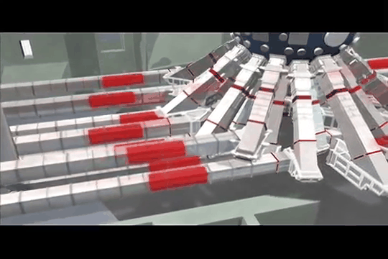
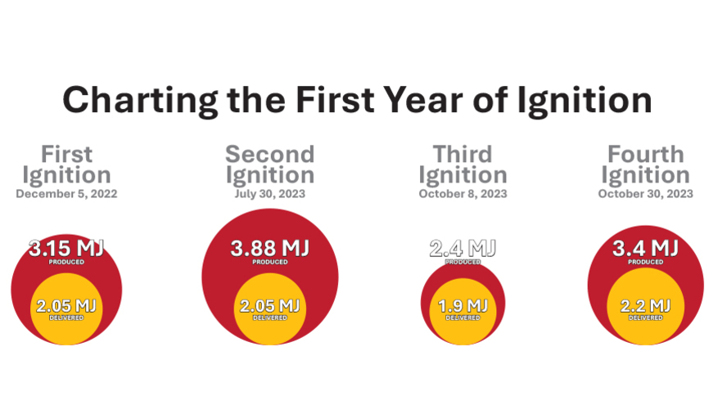
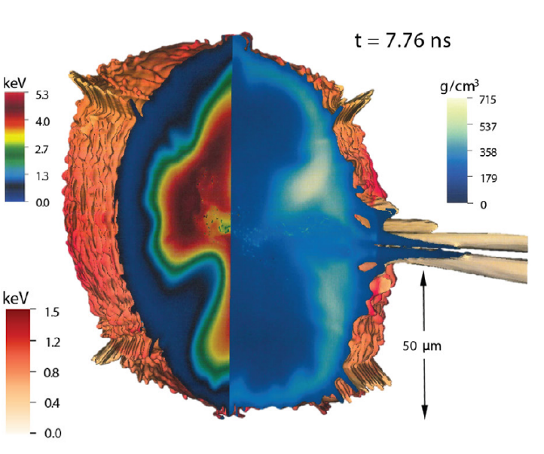
My context
Nuclear fusion – “inertial confinement”
Predictive modelling of plasma behaviour and observable signals

Slide 4

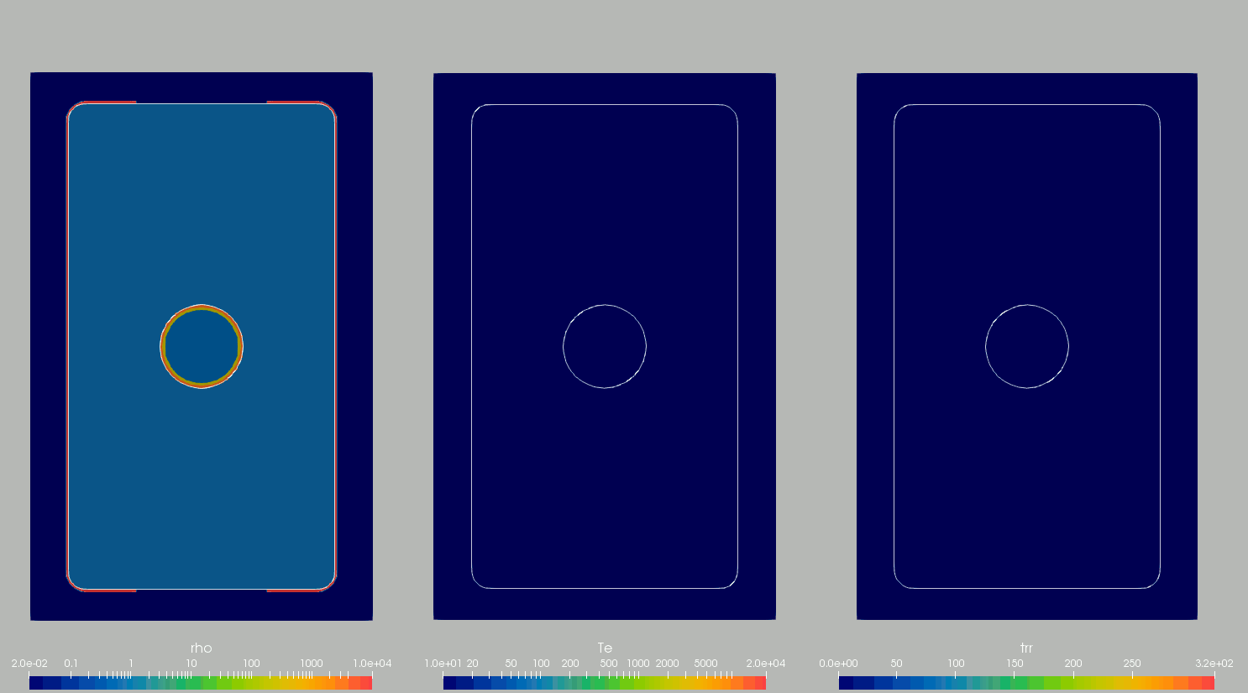
My context
Multi-physics code in 3D:
Magneto-hydrodynamics, radiation transport, thermal conduction, split electron-ion energy equations, laser ray trace, alpha particle transport, non-ideal equation of state, extended Ohm’s law, material strength…

Slide 5
Nature and differential equations
Differential equations have “unreasonable effectiveness” in describing nature*
Newton noted that the circular orbit of the moon and parabolic trajectory of a thrown rock were special cases of an ellipse
2nd order derivative
Can we use ML/AI to augment differential equation models?
* c.f. Wigner, Comms. In Pure and Applied Mathematics (1960)

Slide 6
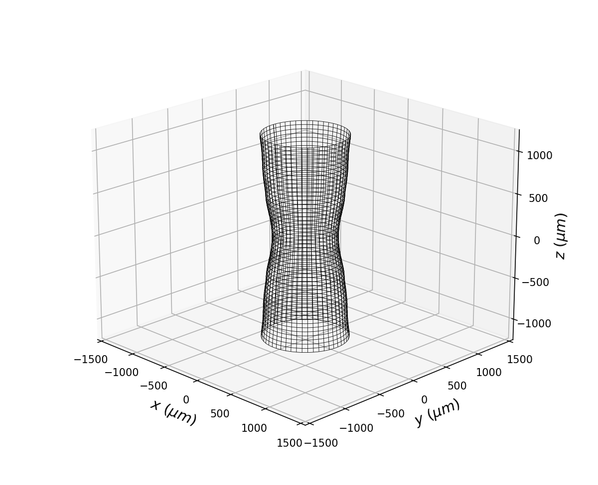
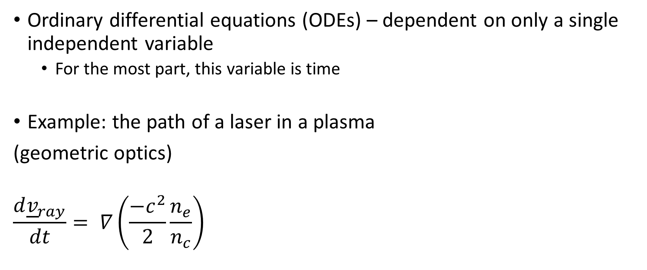
Numerical modelling – ODEs
Ordinary differential equations (ODEs) – dependent on only a single independent variable
For the most part, this variable is time
Example: the path of a laser in a plasma
(geometric optics)
$$\frac{d{\underline{v}}_{ray}}{dt}= ∇\left(\frac{−c^{2}}{2}\frac{n_{e}}{n_{c}}\right)$$

Slide 7
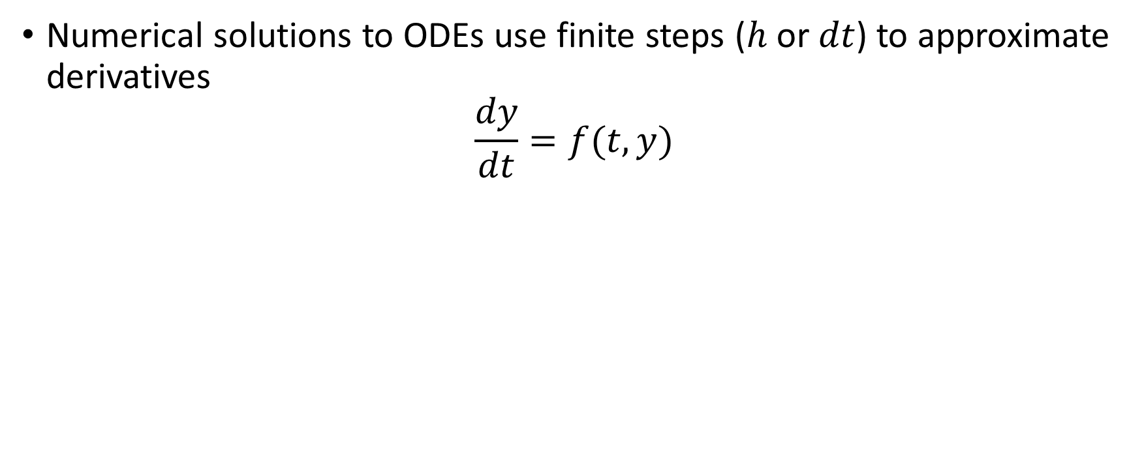
Numerical modelling – ODEs
Numerical solutions to ODEs use finite steps ($h$ or $dt$) to approximate derivatives
$$\frac{dy}{dt}=f(t,y)$$

Slide 8
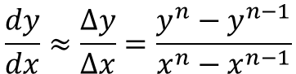
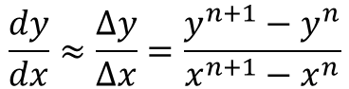
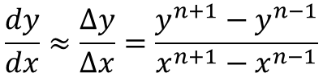
Numerical modelling – ODEs
We use finite differencing to approximate derivatives
Forward differencing:
Backward differencing:
Centred differencing:
$$\frac{dy}{dx}≈\frac{∆y}{∆x}=\frac{y^{n+1}−y^{n}}{x^{n+1}−x^{n}}$$
First order in accuracy
$$\frac{dy}{dx}≈\frac{∆y}{∆x}=\frac{y^{n}−y^{n−1}}{x^{n}−x^{n−1}}$$
$$\frac{dy}{dx}≈\frac{∆y}{∆x}=\frac{y^{n+1}−y^{n−1}}{x^{n+1}−x^{n−1}}$$
Second order in accuracy

Slide 9
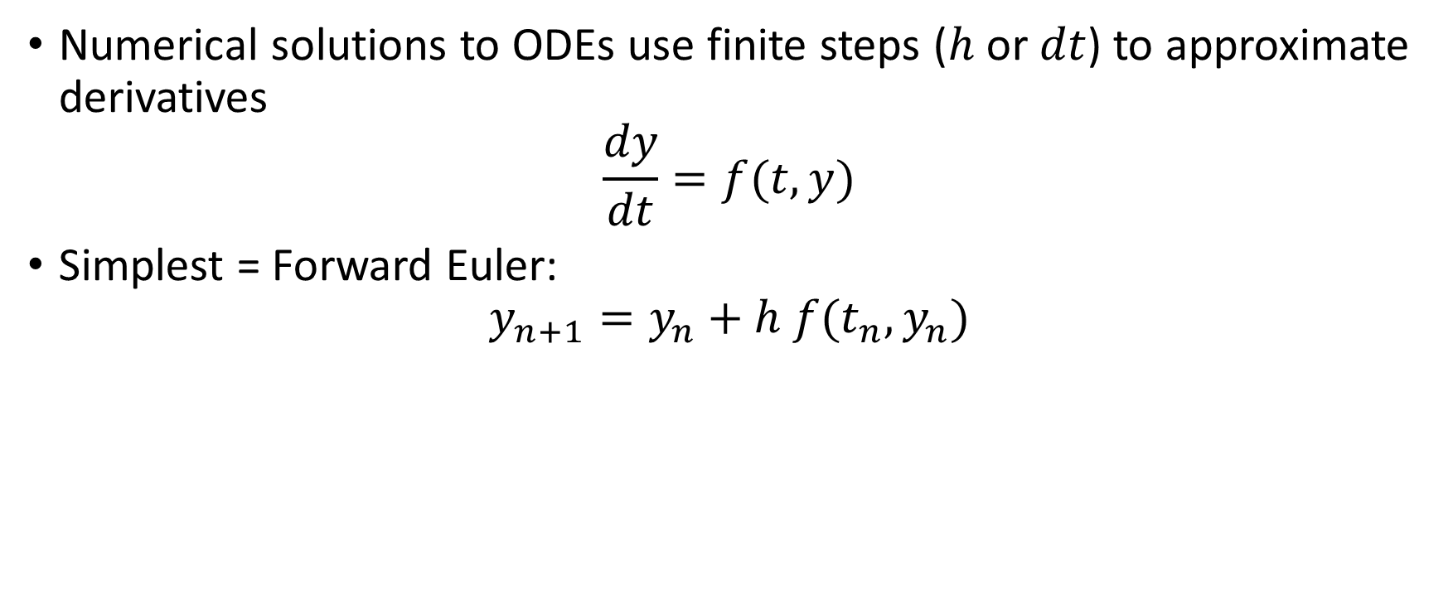
Numerical modelling – ODEs
Numerical solutions to ODEs use finite steps ($h$ or $dt$) to approximate derivatives
$$\frac{dy}{dt}=f(t,y)$$
Simplest = Forward Euler:
$$y_{n+1}=y_{n}+h f(t_{n},y_{n})$$

Slide 10
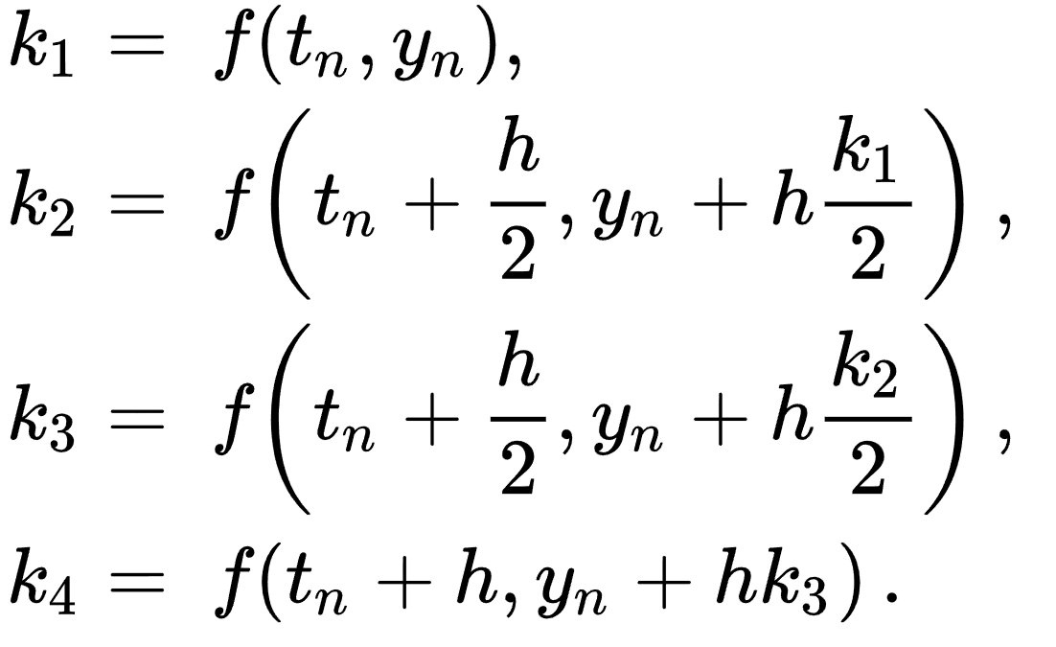
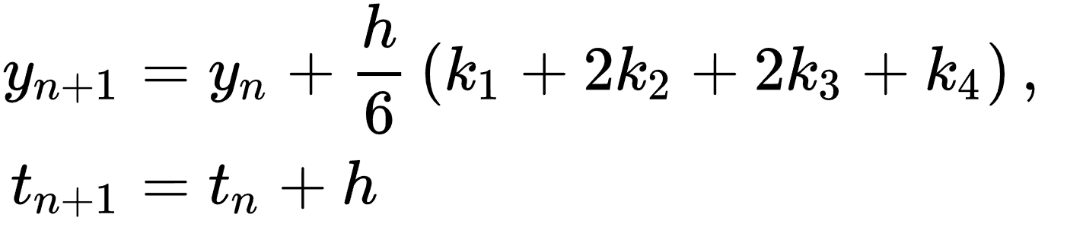
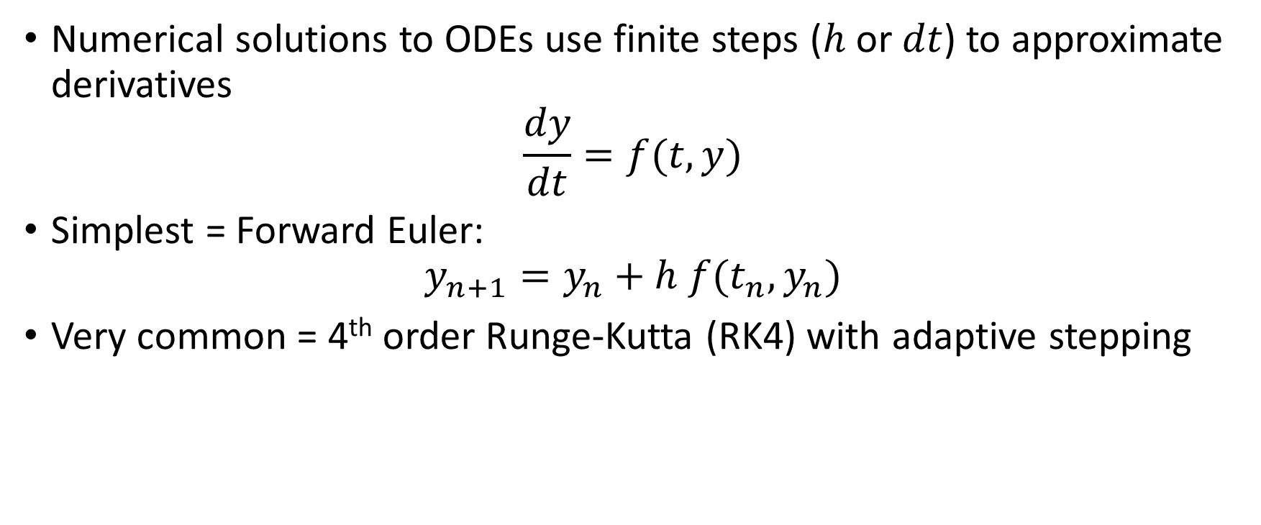
Numerical modelling – ODEs
Numerical solutions to ODEs use finite steps ($h$ or $dt$) to approximate derivatives
$$\frac{dy}{dt}=f(t,y)$$
Simplest = Forward Euler:
$$y_{n+1}=y_{n}+h f(t_{n},y_{n})$$
Very common = 4th order Runge-Kutta (RK4) with adaptive stepping

Slide 11
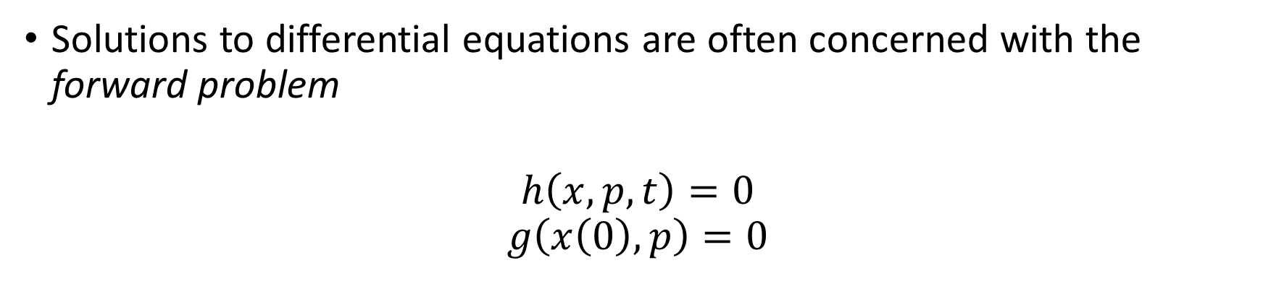
Forward vs Inverse problems
Solutions to differential equations are often concerned with the forward problem
$$h\left(x,p,t\right)=0$$
$$g\left(x\left(0\right),p\right)=0$$
x = state variables
p = parameters
t = time
Differential equation:
Initial condition:
Initial conditions:
Densities, temperatures, etc.
Differential equations:
Hydrodynamics ++
Other parameters: Laser power vs time

Slide 12
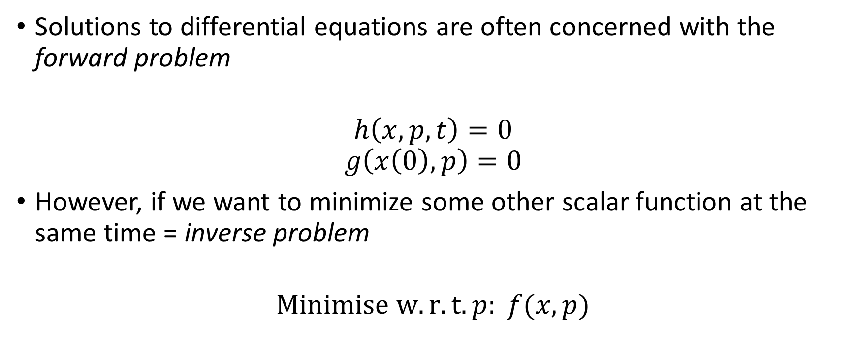
Forward vs Inverse problems
Solutions to differential equations are often concerned with the forward problem
$$h\left(x,p,t\right)=0$$
$$g\left(x\left(0\right),p\right)=0$$
However, if we want to minimize some other scalar function at the same time = inverse problem
$$Minimise w.r.t. p: f(x,p)$$
x = state variables
p = parameters
t = time
Differential equation:
Initial condition:
Figure of merit:

Slide 13
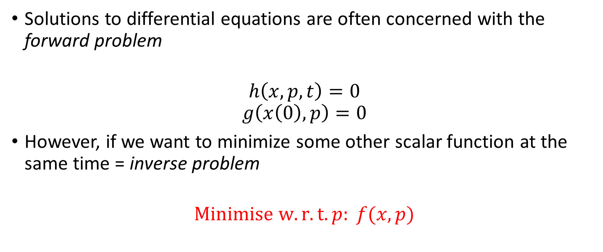
Forward vs Inverse problems
Solutions to differential equations are often concerned with the forward problem
$$h\left(x,p,t\right)=0$$
$$g\left(x\left(0\right),p\right)=0$$
However, if we want to minimize some other scalar function at the same time = inverse problem
$$Minimise w.r.t. p: f(x,p)$$
x = state variables
p = parameters
t = time
Differential equation:
Initial condition:
Figure of merit:
Optimisation

Slide 14
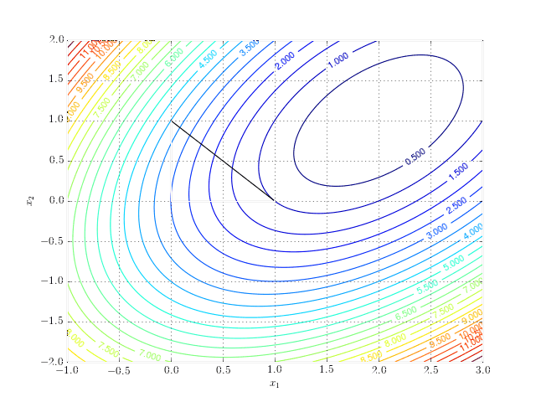
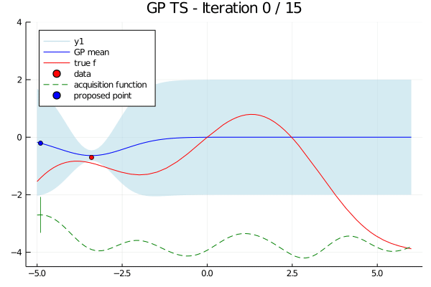
Optimisation
Minimisation = optimisation = root-finding of gradient
Gradient-based vs gradient-free optimisation
Gradient-free:
Downhill-simplex
Bayesian optimisation

Slide 15
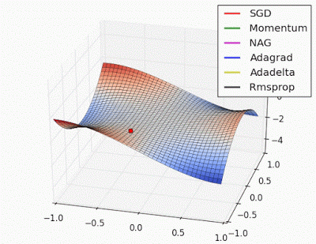
Optimisation
Minimisation = optimisation = root-finding of gradient
Gradient-based:
Simple idea, roll down-hill (to minimize)

Slide 16
The adjoint state problem
How do we solve the inverse problem in differential equations efficiently?
We could run additional forward solutions to get finite difference gradients – very inefficient
Instead of predicting how a single design change influences every aspect of the flow, the adjoint method predicts how every design change influences a single aspect of the flow.

Slide 17
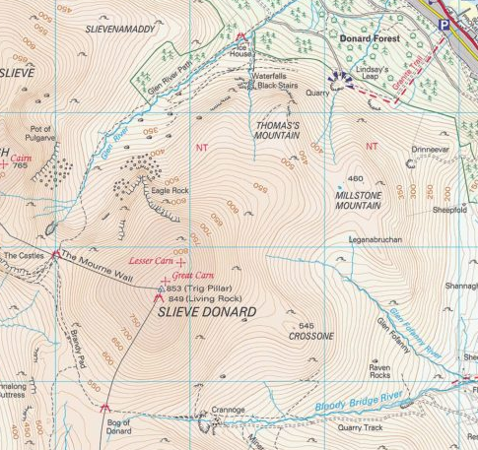
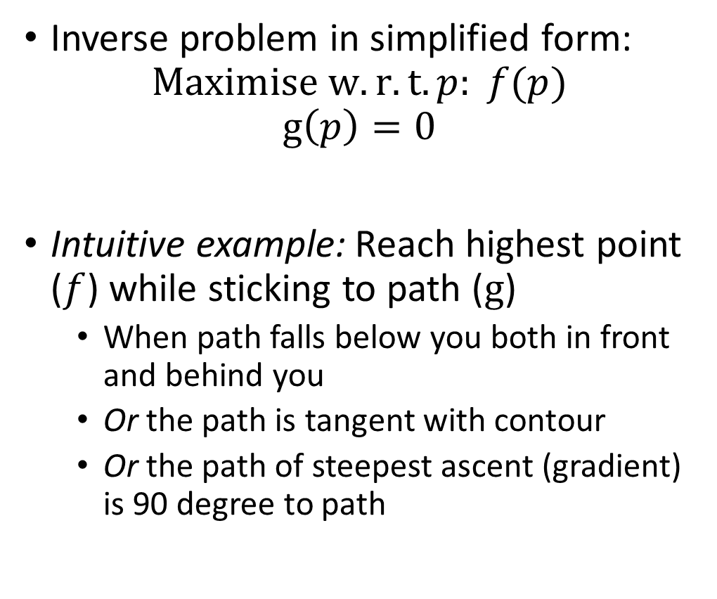
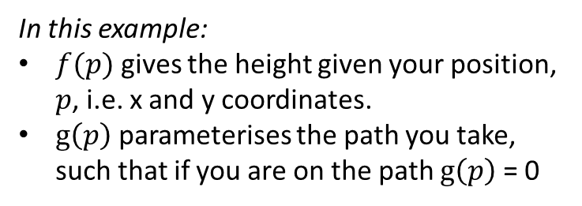
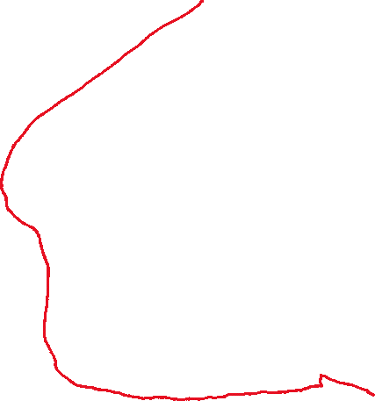
Constrained Optimisation
Inverse problem in simplified form:
$$Maximise w.r.t. p: f(p)$$
$$g\left(p\right)=0$$
Intuitive example: Reach highest point ($f$) while sticking to path ($g$)
When path falls below you both in front and behind you
Or the path is tangent with contour
Or the path of steepest ascent (gradient) is 90 degree to path
In this example:
$f(p)$ gives the height given your position, $p$, i.e. x and y coordinates.
$g\left(p\right)$ parameterises the path you take, such that if you are on the path $g\left(p\right)$ = 0

Slide 18
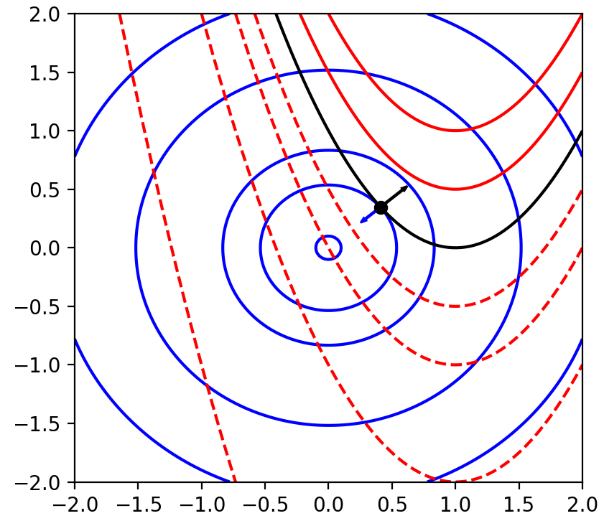
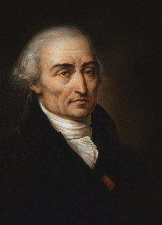
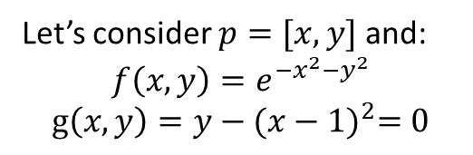
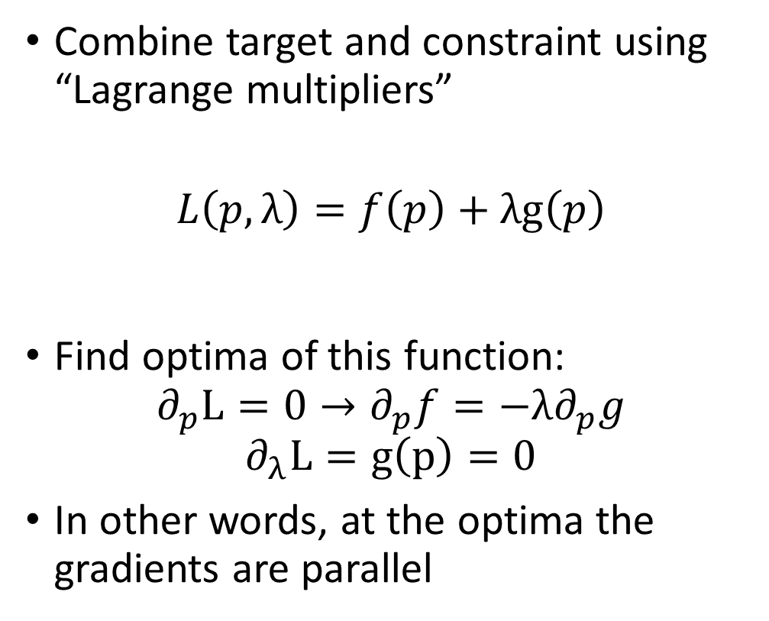
Constrained Optimisation – the maths
Let’s consider $p=[x,y]$ and:
$$f\left(x,y\right)=e^{−x^{2}−y^{2}}$$
$$g\left(x,y\right)=y−{(x−1)}^{2}=0$$
Combine target and constraint using “Lagrange multipliers”
$$L\left(p,λ\right)=f\left(p\right)+λg\left(p\right)$$
Find optima of this function:
$$∂_{p}L=0→∂_{p}f=−λ∂_{p}g$$
$$∂_{λ}L=g\left(p\right)=0$$
In other words, at the optima the gradients are parallel

Slide 19
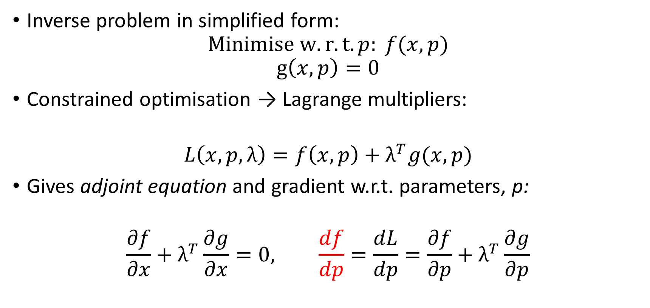
The adjoint state problem
Inverse problem in simplified form:
$$Minimise w.r.t. p: f(x,p)$$
$$g\left(x,p\right)=0$$
Constrained optimisation → Lagrange multipliers:
$$L\left(x,p,λ\right)=f\left(x,p\right)+λ^{T}g(x,p)$$
Gives adjoint equation and gradient w.r.t. parameters, p:
$$\frac{∂f}{∂x}+λ^{T}\frac{∂g}{∂x}=0, \frac{df}{dp}=\frac{dL}{dp}=\frac{∂f}{∂p}+λ^{T}\frac{∂g}{∂p}$$

Slide 20
The adjoint state problem – differentiable programming
For differential equations, the adjoint equation is itself another differential equation
Backpropagation of gradients through our differential equation would implicitly solve adjoint equations
We will show this later…
How do we do get gradients of numerical solutions to differential equations?

Slide 21
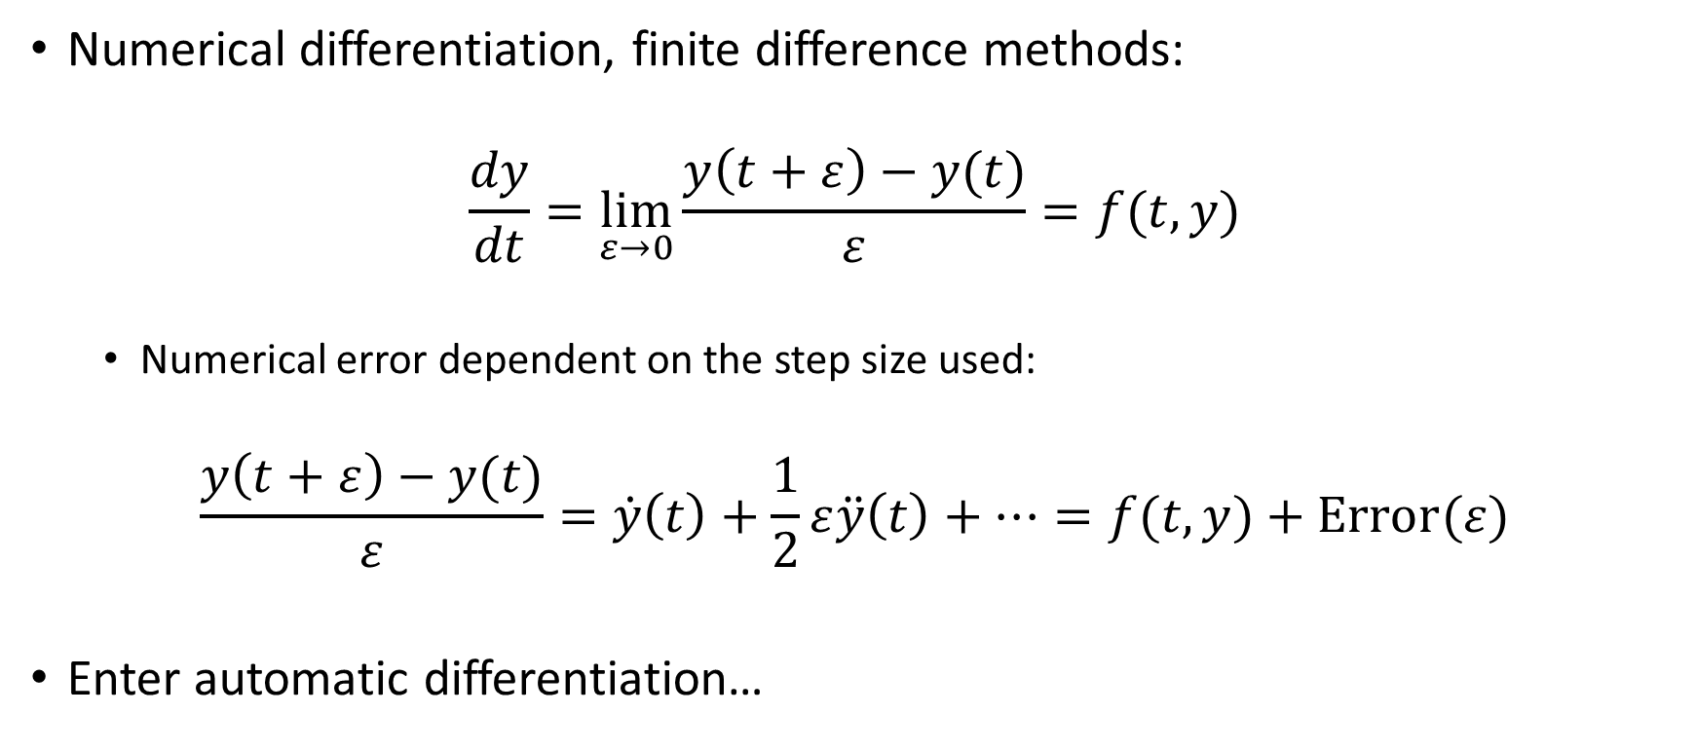
Automatic differentiation introduction
Numerical differentiation, finite difference methods:
$$\frac{dy}{dt}=\lim_{ε→0}{\frac{y\left(t+ε\right)−y(t)}{ε}}=f(t,y)$$
Numerical error dependent on the step size used:
$$\frac{y\left(t+ε\right)−y(t)}{ε}=\dot{y}\left(t\right)+\frac{1}{2}ε\ddot{y}\left(t\right)+…=f(t,y)+Error(ε)$$
Enter automatic differentiation…

Slide 22
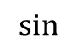


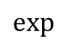

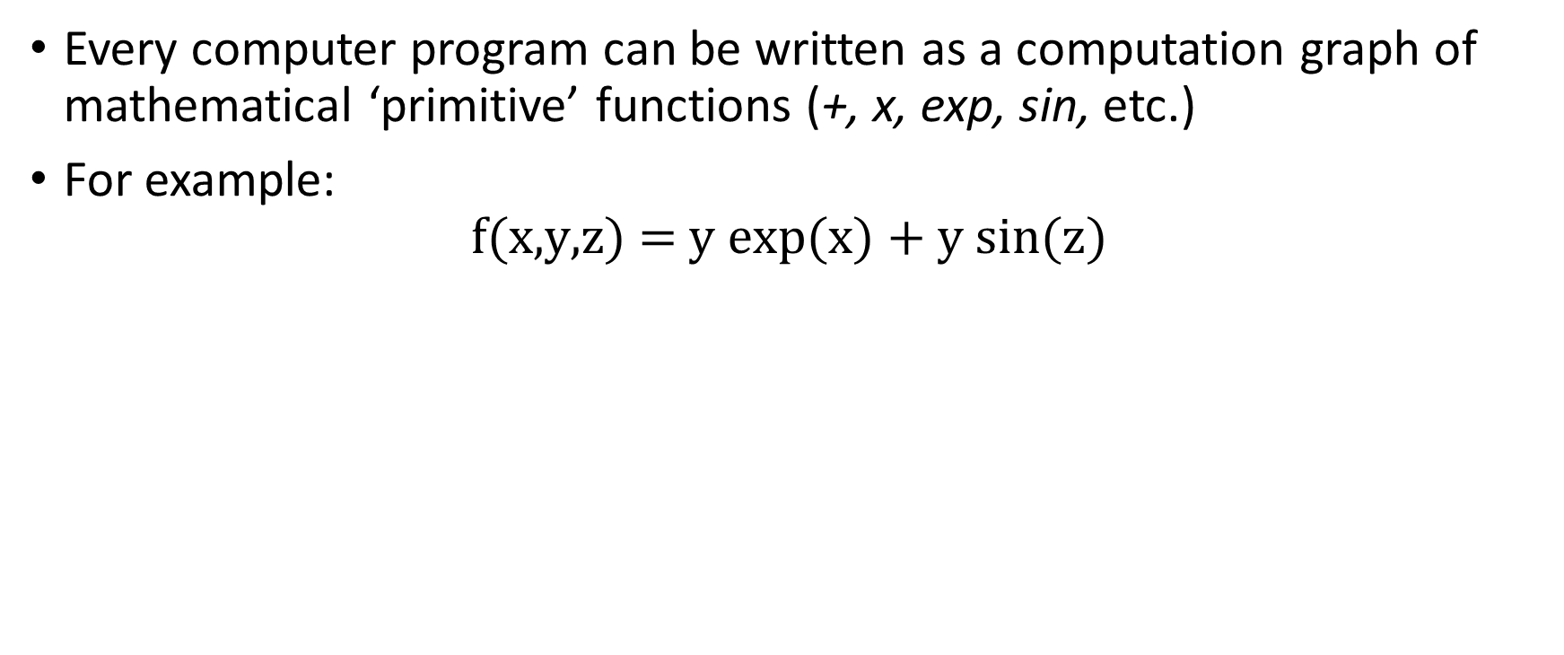
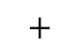


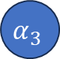


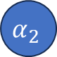


Automatic Differentiation Intro
Every computer program can be written as a computation graph of mathematical ‘primitive’ functions (+, x, exp, sin, etc.)
For example:
$$\text{f}\text{(}\text{x}\text{,}\text{y}\text{,}\text{z}\text{) = }\text{y} \text{exp}\text{(}\text{x}\text{) + }\text{y} \text{sin}\text{(}\text{z}\text{)}$$
x
$$α_{1}$$
$$\text{exp}$$
$$α_{4}$$
$$∗$$
$$α_{6}$$
$$+$$
y
$$α_{2}$$
$$α_{8}$$
$$f$$
$$∗$$
$$α_{7}$$
z
$$α_{3}$$
$$\text{sin}$$
$$α_{5}$$

Slide 23
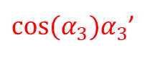

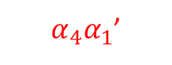
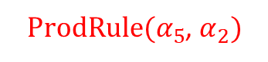
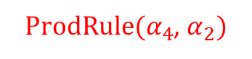
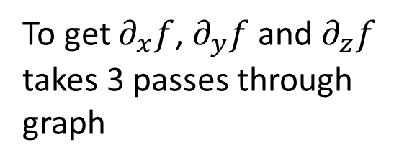
Automatic Differentiation Intro
Every computer program can be written as a computation graph of mathematical ‘primitive’ functions (+, x, exp, sin, etc.)
For example:
$$\text{f}\text{(}\text{x}\text{,}\text{y}\text{,}\text{z}\text{) = }\text{y} \text{exp}\text{(}\text{x}\text{) + }\text{y} \text{sin}\text{(}\text{z}\text{)}$$
x
$$α_{1}$$
$$\text{exp}$$
$$α_{4}$$
$$∗$$
$α_{4}α_{1}$’
$$α_{6}$$
$$+$$
y
$$α_{2}$$
$ProdRule(α_{4}$, $α_{2})$
$$α_{8}$$
$$f$$
$$∗$$
$$α_{7}$$
$α_{6}^{′}+$ $α_{7}$’
z
$$α_{3}$$
$$\text{sin}$$
$$α_{5}$$
$ProdRule(α_{5}$, $α_{2})$
To get $∂_{x}f$, $∂_{y}f$ and $∂_{z}f$ takes 3 passes through graph
$\text{c}\text{os}\text{(}α_{3})α_{3}$’
“Forward mode” automatic differentiation

Slide 24
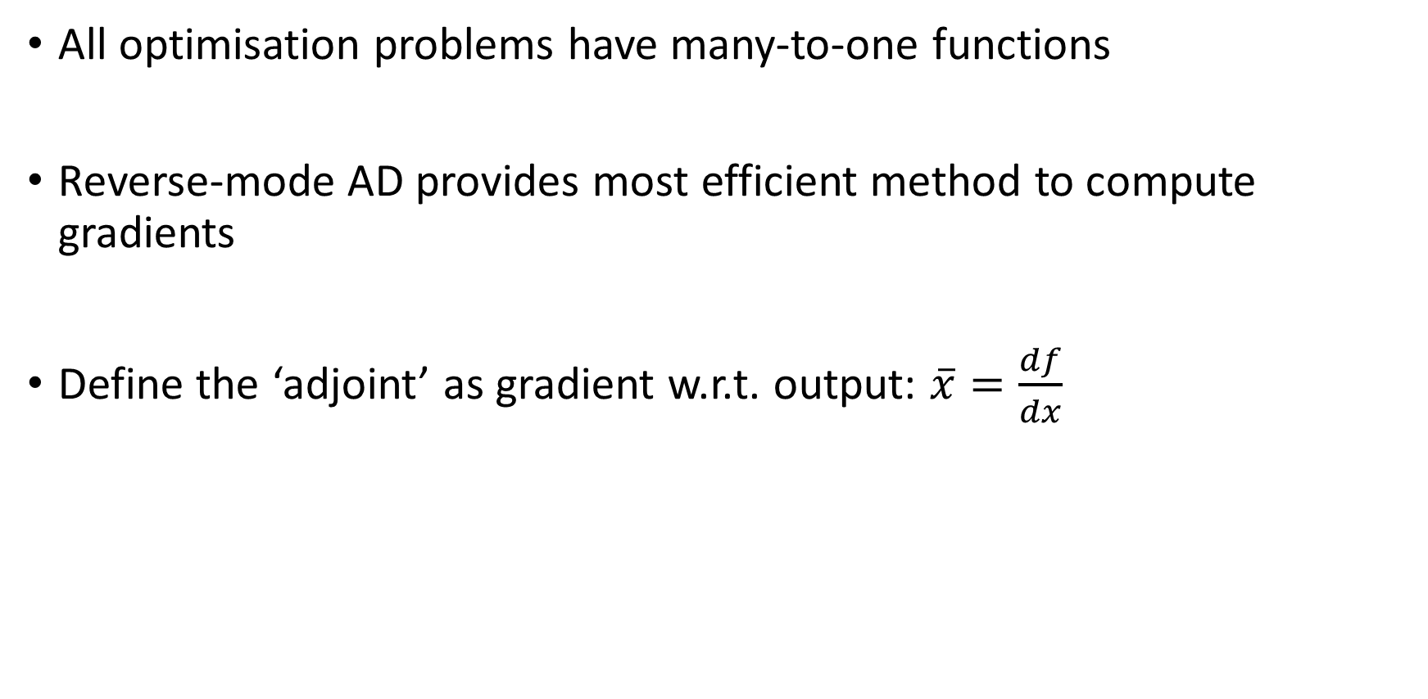
Automatic Differentiation Intro
All optimisation problems have many-to-one functions
Reverse-mode AD provides most efficient method to compute gradients
Define the ‘adjoint’ as gradient w.r.t. output: $\overline{x}=\frac{df}{dx}$

Slide 25


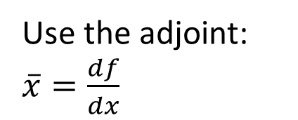
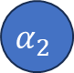
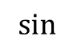

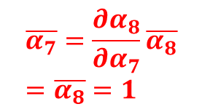

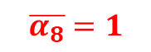
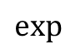


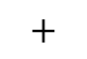

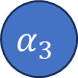


Automatic Differentiation Intro
In our example:
Use the adjoint: $\overline{x}=\frac{df}{dx}$
x
$$α_{1}$$
$$\text{exp}$$
$$α_{4}$$
$$∗$$
$$α_{6}$$
$$+$$
y
$$α_{2}$$
$$α_{8}$$
$$f$$
$$∗$$
$$α_{7}$$
$$\overline{α_{8}}=1$$
z
$$α_{3}$$
$$\text{sin}$$
$$α_{5}$$
$$\overline{α_{7}}=\frac{∂α_{8}}{∂α_{7}}\overline{α_{8}}=\overline{α_{8}}=1$$
Chain rule

Slide 26





Automatic Differentiation Intro
In our example:
$$\overline{α_{1}}=α_{4}\overline{α_{4}}=α_{2}α_{4}$$
$$\overline{α_{4}}=α_{2}\overline{α_{6}}=α_{2}$$
x
$$α_{1}$$
$$\text{exp}$$
$$α_{4}$$
$$\overline{α_{6}}=\overline{α_{8}}=1$$
$$∗$$
$$\overline{α_{2}}=α_{4}\overline{α_{6}}+α_{5}\overline{α_{7}}=α_{4}+α_{5}$$
$$α_{6}$$
$$+$$
y
$$α_{2}$$
$$α_{8}$$
$$f$$
$$∗$$
$$α_{7}$$
$$\overline{α_{8}}=1$$
z
$$α_{3}$$
$$\text{sin}$$
$$α_{5}$$
$$\overline{α_{7}}=\frac{∂α_{8}}{∂α_{7}}\overline{α_{8}}=\overline{α_{8}}=1$$
$$\overline{α_{3}}=cos(α_{3})\overline{α_{5}}=α_{2}cos(α_{3})$$
$$\overline{α_{5}}=α_{2}\overline{α_{7}}=α_{2}$$
A single ‘back-propagation’ gives all gradients!

Slide 27




































Extending the computational graph
x
$$α_{1}$$
$$\text{exp}$$
$$α_{4}$$
$$∗$$
$$α_{6}$$
$$+$$
y
$$α_{2}$$
$$α_{8}$$
$$f$$
$$∗$$
$$α_{7}$$
z
$$α_{3}$$
$$\text{sin}$$
$$α_{5}$$
$$∗$$
$$∗$$
$$\overline{α_{1}}$$
$$\overline{α_{4}}$$
$$\overline{α_{2→6}}$$
$$∗$$
$$\overline{α_{6}}$$
$$id$$
$$\overline{α_{2}}$$
$$+$$
$$\overline{α_{8}}$$
$$1$$
$$cos⁡(α_{3})$$
$$\overline{α_{2→7}}$$
$$∗$$
$$\overline{α_{7}}$$
$$id$$
$$∗$$
$$id$$
$$\overline{α_{3}}$$
$$∗$$
$$\overline{α_{5}}$$

Slide 28



Extending the computational graph
x
$$α_{1}$$
$$\text{exp}$$
$$α_{4}$$
$$∗$$
$$α_{6}$$
$$+$$
y
$$α_{2}$$
$$α_{8}$$
$$f$$
$$∗$$
$$α_{7}$$
z
$$α_{3}$$
$$\text{sin}$$
$$α_{5}$$
A single computational graph computes the forward function and the adjoint
It is clear which forward pass values need to be stored ($α_{2}$, $α_{3}$, $α_{4}$, $α_{5}$)
$$∗$$
$$∗$$
$$\overline{α_{1}}$$
$$\overline{α_{4}}$$
$$\overline{α_{2→6}}$$
$$∗$$
$$\overline{α_{2}}$$
$$1$$
$$cos⁡(α_{3})$$
$$+$$
$$\overline{α_{2→7}}$$
$$∗$$
$$∗$$
$$∗$$
$$\overline{α_{3}}$$
$$\overline{α_{5}}$$

Slide 29

Differentiable Programming?
Yann LeCun:
“Deep Learning est mort. Vive Differentiable Programming!
…
An increasingly large number of people are defining the networks procedurally in a data-dependent way (with loops and conditionals), allowing them to change dynamically as a function of the input data fed to them. It's really very much like a regular progam, except it's parameterized, automatically differentiated, and trainable/optimizable. Dynamic networks have become increasingly popular…”

Slide 30
Automatic-differentiation/differentiable-programming frameworks
Python: PyTorch – autograd
Python: Tensorflow – GradientTape
Python: JAX
C++: autodiff
Check out autodiff.org for other languages/libraries

Slide 31
Automatic-differentiation/differentiable-programming frameworks
Python: PyTorch – autograd
Python: Tensorflow – GradientTape
Python: JAX
C++: autodiff
Check out autodiff.org for other languages/libraries

Slide 32

PythonJAX simple example
In our example:
$$\overline{α_{1}}=α_{4}\overline{α_{4}}=α_{2}α_{4}$$
$$\overline{α_{4}}=α_{2}\overline{α_{6}}=α_{2}$$
x
$$α_{1}$$
$$\text{exp}$$
$$α_{4}$$
$$\overline{α_{6}}=\overline{α_{8}}=1$$
$$∗$$
$$\overline{α_{2}}=α_{4}\overline{α_{6}}+α_{5}\overline{α_{7}}=α_{4}+α_{5}$$
$$α_{6}$$
$$+$$
y
$$α_{2}$$
$$α_{8}$$
$$f$$
$$∗$$
$$α_{7}$$
$$\overline{α_{8}}=1$$
z
$$α_{3}$$
$$\text{sin}$$
$$α_{5}$$
$$\overline{α_{7}}=\frac{∂α_{8}}{∂α_{7}}\overline{α_{8}}=\overline{α_{8}}=1$$
$$\overline{α_{3}}=cos(α_{3})\overline{α_{5}}=α_{2}cos(α_{3})$$
$$\overline{α_{5}}=α_{2}\overline{α_{7}}=α_{2}$$
A single ‘back-propagation’ gives all gradients!

Slide 33


Advanced example – Leibniz integral rule
Differentiation under the integral sign
$$I\left(x;a,b,θ\right)= \int_{a}^{b}{f\left(x,θ\right)dx}$$
$$\frac{∂I}{∂a}=−f\left(a,θ\right), \frac{∂I}{∂b}=f\left(b,θ\right), \frac{∂I}{∂θ_{i}}=\int_{a}^{b}{\frac{∂f}{∂θ_{i}}dx}$$
Integral evaluated using adaptive quadrature e.g.

Slide 34


Advanced example – Leibniz integral rule
Differentiation under the integral sign
$$I\left(x;a,b,θ\right)= \int_{a}^{b}{f\left(x,θ\right)dx}$$
$$\frac{∂I}{∂a}=−f\left(a,θ\right), \frac{∂I}{∂b}=f\left(b,θ\right), \frac{∂I}{∂θ_{i}}=\int_{a}^{b}{\frac{∂f}{∂θ_{i}}dx}$$
Integral evaluated using adaptive quadrature

Slide 35
Back to differential equations…

Slide 36












What if our function is a solution to an ODE?
A simple example ODE, solved using Euler’s method
$$\frac{dy}{dt}=−\frac{1}{τ}y, y_{n+1}=\left(1−\frac{dt}{τ}\right)y_{n}=δy_{n}$$
Define some loss, $\text{f}$, which uses values of y
It’s just a graph
We can compute $d_{τ}\text{f}$, $d_{dt}\text{f}$ and $d_{y_{0}}\text{f}$ using back-propagation
$$y_{0}$$
$$y_{1}$$
$$y_{2}$$
…
$$y_{N}$$
$$∗$$
$$∗$$
$$∗$$
$$τ$$
$$δ$$
$$\text{f}$$
dt

Slide 37

What if our function is a solution to an ODE?
A simple example ODE, with parameters $y_{0}$ and $τ$
$$\frac{dy}{dt}=−\frac{1}{τ}y, f=L\left(y\left(T\right)\right)$$
What are the formal adjoint equations?
There will be differential equations for
Adjoint process (Lagrange multiplier)
Parameter gradients (df/dp)

Slide 38

What if our function is a solution to an ODE?
A simple example ODE, with parameters $y_{0}$ and $τ$
$$\frac{dy}{dt}=−\frac{1}{τ}y, f=L(y\left(T\right))$$
What are the formal adjoint equations?
$$\frac{dα}{dt}=\frac{1}{τ}α, α\left(T\right)=\frac{dL}{dy\left(T\right)}$$
$$\frac{dβ}{dt}=−\frac{1}{τ^{2}}αy, β\left(T\right)=0$$
Solved backwards in time, $β\left(0\right)= d_{τ}f=\left(\frac{T}{τ^{2}}\right)\left(\frac{dL}{dy\left(T\right)}\right)y_{0}exp\left[−\frac{T}{τ}\right]$
Adjoint process:
Exponential growth
Parameter gradients:
Ref: https://proceedings.mlr.press/v144/ainsworth21a/ainsworth21a.pdf

Slide 39











What if our function is a solution to an ODE?
$$y_{0}$$
$$y_{1}$$
$$y_{2}$$
…
$$y_{N}$$
$$∗$$
$$∗$$
$$∗$$
$$τ$$
$$δ$$
$$\text{f}$$
$$y_{N}=\left(1−\frac{dt}{τ}\right)y_{N−1},$$
Backpropagation a single step:
$$\frac{df}{dτ}=\frac{dL}{dy_{N}}∙\frac{dy_{N}}{dτ}$$
$$\frac{dy_{N}}{dτ}=\frac{d}{dτ}\left[\left(1−\frac{dt}{τ}\right)y_{N−1}\right]$$
dt

Slide 40

What if our function is a solution to an ODE?
$$y_{0}$$
$$y_{1}$$
$$y_{2}$$
…
$$y_{N}$$
$$∗$$
$$∗$$
$$∗$$
$$τ$$
$$δ$$
$$\text{f}$$
$$y_{N}=\left(1−\frac{dt}{τ}\right)y_{N−1},$$
Backpropagation a single step:
$$\frac{df}{dτ}=\frac{dL}{dy_{N}}∙\frac{dy_{N}}{dτ}=\frac{dL}{dy_{N}}∙\left(\frac{dt}{τ^{2}}y_{N−1}+\left(1−\frac{dt}{τ}\right)\frac{dy_{N−1}}{dτ}\right)$$
dt

Slide 41

What if our function is a solution to an ODE?
$$y_{0}$$
$$y_{1}$$
$$y_{2}$$
…
$$y_{N}$$
$$∗$$
$$∗$$
$$∗$$
$$τ$$
$$y_{n}={\left(1−\frac{dt}{τ}\right)}^{n}y_{0},$$
Backpropagation all the way:
$$\frac{df}{dτ}=\frac{T}{τ^{2}}\frac{dL}{dy_{N}}y_{0}{\left(1−\frac{T}{Nτ}\right)}^{N−1}, T=Ndt$$
$$β\left(0\right)=\frac{T}{τ^{2}}\frac{dL}{dy(T)}y_{0}exp\left[−\frac{T}{τ}\right]$$
$$δ$$
$$\text{f}$$
dt
AD + ODE:
Backprop of ODE solution numerically solves adjoint state method
= “discretise-then-optimise”
Analytic adjoint state method:

Slide 42





























Extending the computational graph
Solving 3 ODEs with shared time step and method
$$y_{0}$$
$$y_{1}$$
$$y_{2}$$
…
$$y_{N}$$
$$∗$$
$$∗$$
$$∗$$
$$τ$$
$$δ$$
$$\text{f}$$
dt
$$\frac{dL}{dy\left(T\right)}$$
$$τ^{2}$$
$$α_{0}$$
$$α_{1}$$
$$α_{2}$$
…
$$α_{N}$$
$$ε$$
$$∗$$
$$∗$$
$$∗$$
Etc.
$$β_{0}$$
$$β_{1}$$
$$β_{2}$$
…
$$β_{N}$$
$$0$$
$$∗$$
$$∗$$
$$∗$$

Slide 43








An abstraction
$$y_{0}$$
Solve:
$$\frac{dy}{dt}=−\frac{1}{τ}y$$
$$\text{f}$$
Required y values needed by adjoint solution
$$τ$$
$$\frac{dL}{dy\left(T\right)}$$
Solve:
$$\frac{dα}{dt}=\frac{1}{τ}α,$$
$$\frac{dβ}{dt}=−\frac{1}{τ^{2}}αy$$
$$β_{0}$$
$$0$$

Slide 44
Colab Exercise 1

Slide 45
ODE differentiable programming libraries
Diffrax – JAX-based library providing numerical differential equation solvers
SciMLSensitivity.jl – Julia-based library, AD and adjoints for differential equations solvers (and more…)

Slide 46
ODE differentiable programming libraries
Diffrax – JAX-based library providing numerical differential equation solvers
SciMLSensitivity.jl – Julia-based library, AD and adjoints for differential equations solvers (and more…)

Slide 47

Diffrax example
Diffrax has 4 key features (for our purposes):
Terms
Solvers
Adaptive stepping
Adjoints

Slide 48

Diffrax example
Diffrax has 4 key features (for our purposes):
Terms
Solvers
Adaptive stepping
Adjoints

Slide 49



Numerical modelling – PDEs
Partial differential equations (PDEs) – dependent on only many independent variables
For the most part, these variables are space and time
Total derivative vs. partial derivative
$$\frac{d}{dt}\left[f(x,t)\right]=\frac{∂f}{∂t}+\frac{∂x}{∂t}∙\frac{∂f}{∂x}=\frac{∂f}{∂t}+v_{x}∙\frac{∂f}{∂x}$$
Example: Hydrodynamics

Slide 50

Numerical modelling – PDEs
Method of lines for time dependent PDEs
Discretising all but the time dimension turns PDE → system of ODEs
For example, the heat equation:
$$\frac{∂T(x,t)}{∂t}=k\frac{∂^{2}T(x,t)}{∂x^{2}}$$
Becomes (centred-space differencing):
$$\frac{dT(x_{i},t)}{dt}=k\left(\frac{T\left(x_{i+1},t\right)−2T\left(x_{i},t\right)−T(x_{i−1},t)}{{∆x}^{2}}\right)$$

Slide 51

Numerical modelling – PDEs
Method of lines for time dependent PDEs
Discretising all but the time dimension turns PDE → system of ODEs
For example, the heat equation:
$$\frac{∂T(x,t)}{∂t}=k\frac{∂^{2}T(x,t)}{∂x^{2}}$$
Becomes:
$$\frac{dT(t)}{dt}=k\underline{D}T(t)$$
Where $T$ is a vector of $T(x_{i},t)$ at discrete points $x_{i}$

Slide 52










What if our function is a solution to a PDE?
Spatial discretisation makes time-space PDEs into time ODEs
Explicit time-stepping easiest:
$$\frac{dy}{dt}=L\left(y,θ\right) \underset{→}{\text{discretise}} y_{n+1}=\left(\underline{1}−\underline{L}(y_{n},θ)dt\right)y_{n}={\underline{A}}_{n}y_{n}$$
Initial conditions
We can modify our initial conditions or our model parameters to minimise the loss
$$y_{0}$$
$$y_{1}$$
$$y_{2}$$
…
$$y_{N}$$
$$A_{0}$$
$$A_{1}$$
$$A_{2}$$
…
$$\text{ℒ}$$
Model parameters
$$θ$$

Slide 53
Recipe for differentiable solver
Specify your ODE/PDE
Choose spatial (and temporal) differencing scheme
Define loss term for optimisation purposes
Compute adjoint system via ‘discretise-then-optimise’ or ‘optimise-then-discretise’ strategies

Slide 54
Recipe for differentiable solver
Specify your ODE/PDE
Choose spatial (and temporal) differencing scheme
Define loss term for optimisation purposes
Compute adjoint system via ‘discretise-then-optimise’ or ‘optimise-then-discretise’ strategies

Slide 55

Backpropagating through a fluid simulation
Modify the initial conditions (velocities) to match some input image after a set simulation time
Steps:
Write a fluid simulator in a differentiable programming framework – in this case AutoGrad
Initialise some densities and x,y velocities on nx by ny grid
Find distance to target image (loss) after N simulation iterations
Use Jacobian of loss to update initial velocities (2x nx x ny values)
https://github.com/HIPS/autograd/blob/master/examples/fluidsim/fluidsim.py

Slide 56
Neural Networks for differential equations
Many examples, will note two here:
Neural differential equations
Physics-informed neural networks

Slide 57

Neural Differential Equations
Ref: On Neural Differential Equations, P. Kidger, Thesis
What if what to describe a dynamical system but don’t know the form of (some of) the terms?
$$\frac{dy}{dt}=L\left(t,y\right)+N_{θ}(t,y)$$
Neural network parameters learnt using adjoint state method
Known operations
Unknown operations – neural network

Slide 58


Physics Informed Neural Networks (PINNs)
Ref: Physics-informed neural networks…, Raissi, J. Comp. Phys., 2018
What if we know some physical law we want our NN to respect?
PINN, note NN is solution not operator in NDE:
$$y_{NN}(x,t)→y(x,t)$$
$$g_{PDE}≔ \frac{∂y}{∂t}+f\left(y;x,t\right)=0$$
Include a loss term which ensure $g_{PDE}$ is (approximately) respected:
$$L=L_{y}+L_{g}$$
Want to train NN $y_{NN}(x,t)$ to match some data while respecting physical law $g_{PDE}$ (or boundary condition)

Slide 59


Physics Informed Neural Networks
For example, diffusion:
$$y_{NN}(x,t)→y(x,t)$$
$$g_{PDE}≔ \frac{∂y}{∂t}−D\frac{∂^{2}y}{∂x^{2}}=0$$
$$L=\frac{1}{N}\sum{{\left(y_{NN}−y\right)}^{2}}+\frac{1}{N}\sum{{\left(\frac{∂y_{NN}}{∂t}−D\frac{∂^{2}y_{NN}}{∂x^{2}}\right)}^{2}}$$

Slide 60
Colab Exercise 2

